Slide 1


Advanced Computer Architecture Fall 2019
Hamed Farbeh
farbeh@aut.ac.ir
Department of Computer Engineering
Amirkabir University of Technology
Lecture 5

Slide 2
Copyright Notice
Lectures adopted from
Computer Architecture: A Quantitative Approach, 5th edition, John L. Hennessy,‎ David A. Patterson, MK pub., 2019
Advanced Computer Architecture-Spring 2018, AUT, Tehran, Iran

Slide 3
Computer Architecture
A Quantitative Approach, Sixth Edition
Chapter 3
Instruction-Level Parallelism and Its Exploitation

Slide 4
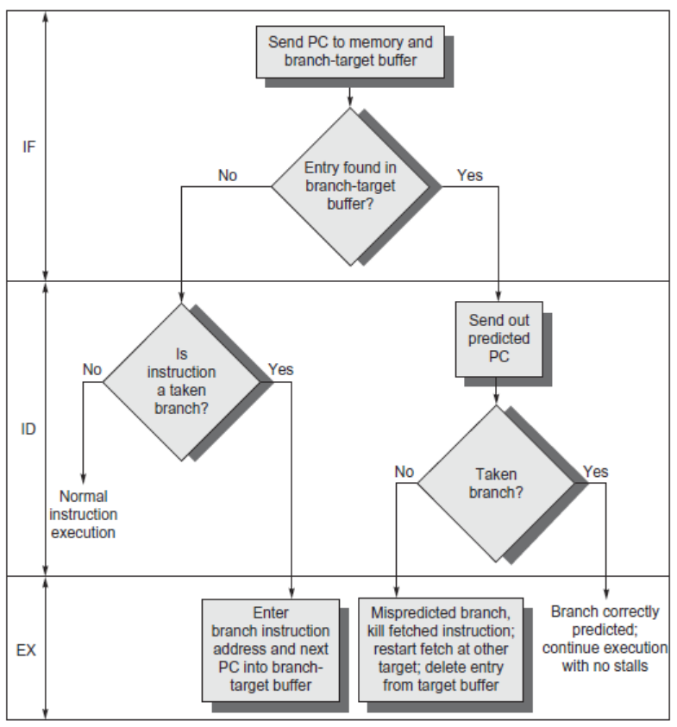
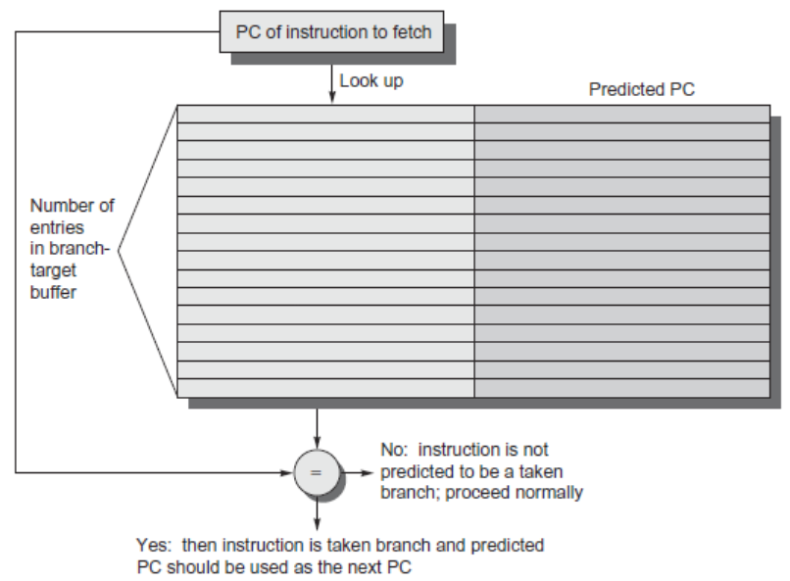
Branch-Target Buffer
Need high instruction bandwidth
Branch-Target buffers
Next PC prediction buffer, indexed by current PC
Adv. Techniques for Instruction Delivery and Speculation

Slide 5
Branch Folding
Optimization:
Larger branch-target buffer
Add target instruction into buffer to deal with longer decoding time required by larger buffer
“Branch folding”
Adv. Techniques for Instruction Delivery and Speculation

Slide 6
Return Address Predictor
Most unconditional branches come from function returns
The same procedure can be called from multiple sites
Causes the buffer to potentially forget about the return address from previous calls
Create return address buffer organized as a stack
Adv. Techniques for Instruction Delivery and Speculation

Slide 7
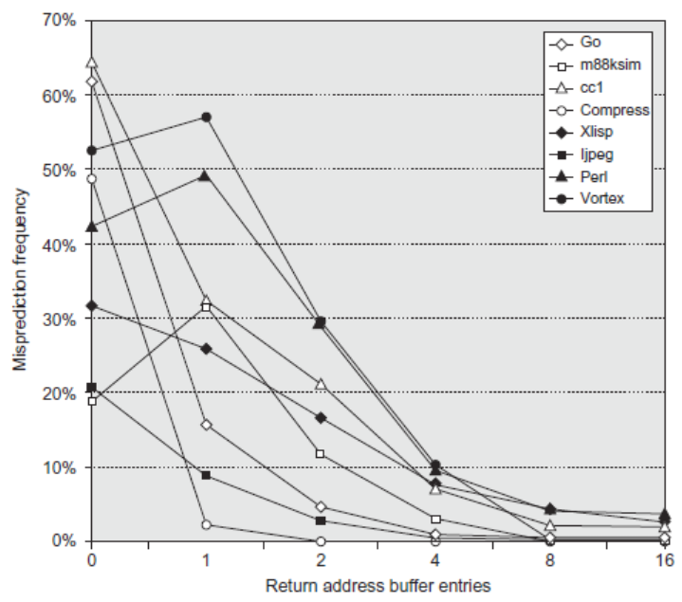
Return Address Predictor
Adv. Techniques for Instruction Delivery and Speculation

Slide 8
How Much?
How much to speculate
Mis-speculation degrades performance and power relative to no speculation
May cause additional misses (cache, TLB)
Prevent speculative code from causing higher costing misses (e.g. L2)
Speculating through multiple branches
Complicates speculation recovery
Speculation and energy efficiency
Note: speculation is only energy efficient when it significantly improves performance
Adv. Techniques for Instruction Delivery and Speculation

Slide 9
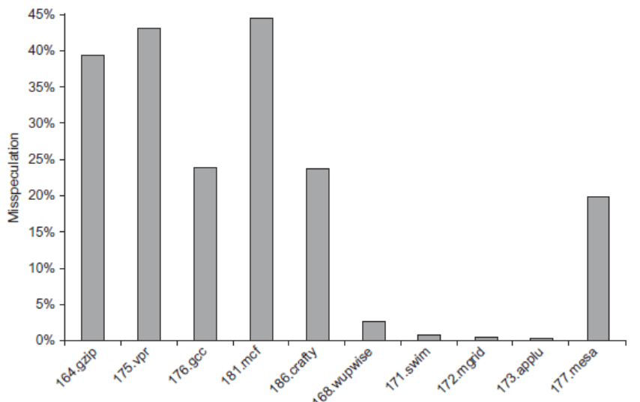
How Much?
integer
Adv. Techniques for Instruction Delivery and Speculation

Slide 10
Energy Efficiency
Value prediction
Uses:
Loads that load from a constant pool
Instruction that produces a value from a small set of values
Not incorporated into modern processors
Similar idea--address aliasing prediction--is used on some processors to determine if two stores or a load and a store reference the same address to allow for reordering
Adv. Techniques for Instruction Delivery and Speculation

Slide 11
Branch Prediction (Articles)
Branch prediction using both global and local branch history information - JNL02 (LGshare)
Improving branch prediction by dynamic data flow-based identification of correlated branches from a large global history - CNF03
Comparison of branch prediction schemes for superscalar processors ICEEC 2004 - CNF04
Better branch prediction through prophet-critic hybrids - JNL05.pdf
Worst-case execution time analysis for dynamic branch predictors - CNF04
Low-cost branch folding for embedded applications with small tight loops - CNF99
Simulation Differences Between Academia and Industry- A Branch Prediction Case Study → Simplescalar

